Slide 1
Data science Projekt
Group 10
Florian Hinrichsen
Kirill Norinskiy
Cat lam tang
Tino Hinrichs

Slide 2

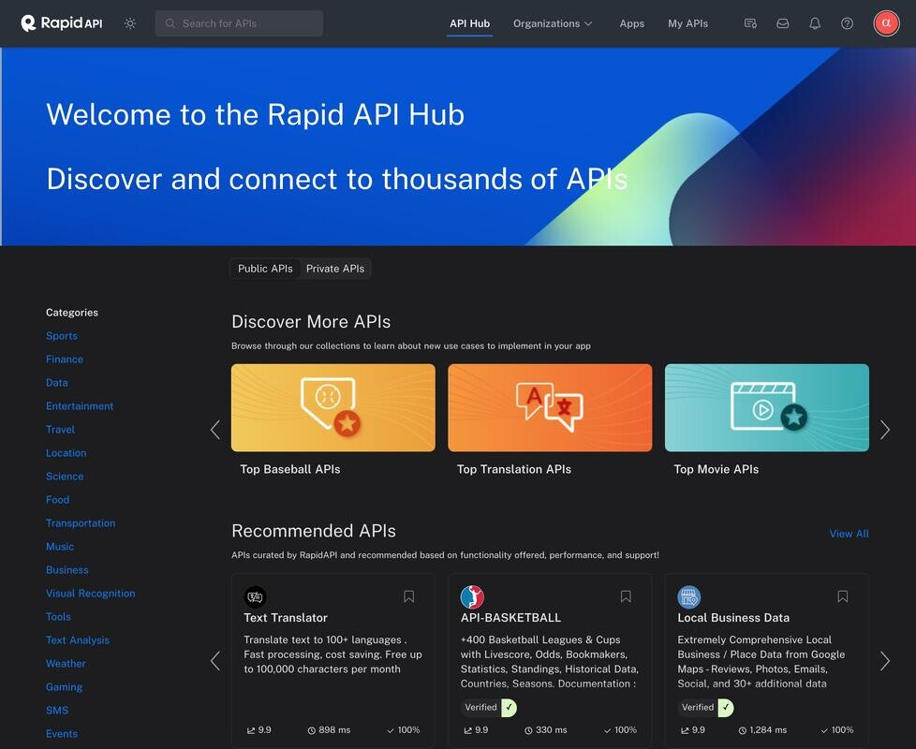
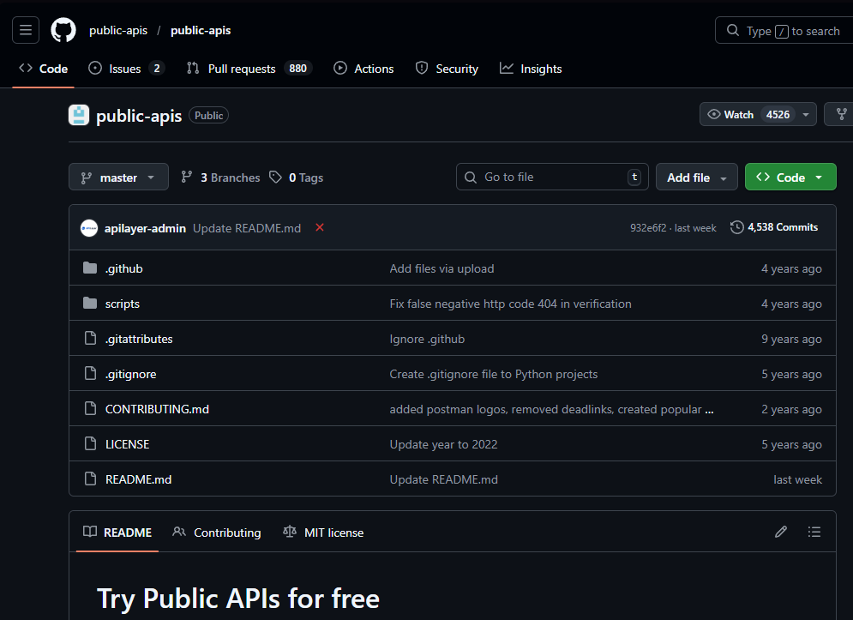

Slide 3

Football
APIs:
https://www.football-data.org
https://www.whoscored.com/statistics
https://www.transfermarkt.de/
Scope:
Each question is about the 2024-25 Bundesliga season.

Slide 4
Research questions:
How does the weather affect the number of goals in a match?
How does the remaining contract duration affect a player's performance as measured by the overall rating on who scored?
How does the time between winning possession in your own half and the first shot correlate with the probability of scoring (per shot)?
Which players perform particularly well in home matches and which in away matches?

Slide 5
5. What is the relationship between transfer spending and league points?
6. How does the league position affect ticket prices?
7. What is the relationship between the number of spectators and the number of cards issued (for the home team) per foul?
8. How do the number and average timing of substitutions affect the number of shots on goal?
9. How does the average player age affect a team's efficiency (goals per shot)?

Slide 6

Movies
APIs:
https://developer.themoviedb.org/
Scope:
Rating of a movie and popularity of an actor refers to the rating and popularity from themoviedb.
We only look at actors with a popularity higher than 60.
We only look at movies which are in the themoviedb.

Slide 7
Research questions:
How has the average film budget developed in in the top five film producing countries?
How does the average length of films differ in the top five film producing countries by Comedy, Action and Crime?
How does the length of a film affect its rating by Comedy, Action and Crime?
What is the average rating of a film from a particular production company?

Slide 8
5. How does the budget affect the rating by Comedy, Action and Crime?
6. How does the budget affect the number of actors?
7. How does the release month of a film affect its box office receipts/ratings?
8. How does the popularity of a film's actors affect its budget/ratings?
9. How does the age of an actor affect their popularity?

Slide 9
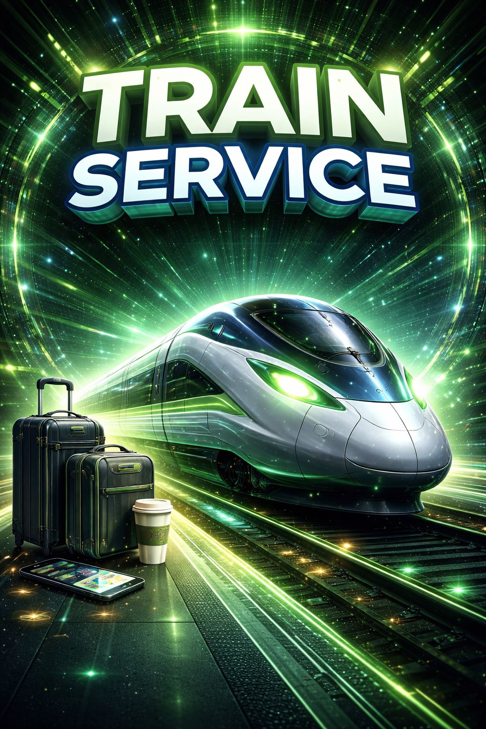
Train services
APIs:
RIS::Stations | DB API Marketplace
Scope:
We only look at the Deutsche Bahn.
We only look at the states of Schleswig-Holstein and Hamburg unless specified otherwise.

Slide 10
Research questions:
How does punctuality change throughout the day?
How does the size of the city where a train station is located affect the accessibility of the station?
How does punctuality differ between the seasons?
How does population density along the railway line affect punctuality?

Slide 11
5. How does the geographical location of a train station affect the functionality of the elevators?
6. How do Hamburg Central Station and Frankfurt Central Station differ in terms of punctuality?
7. How does the number of lines (per track) affect punctuality?
8. How does the weather affect punctuality in Berlin and Kiel?
9. What impact do major events (e.g., football matches, concerts) have on punctuality?

Slide 12


